Slide 1
Dominance matrices in AFL _________________________ Do they actually work?
Agenda:
Introduction:
Definition
Objective
Key terminology:
Method use: win-loss records vs ratio-scores matrices
Dominance Matrix (D(m))
First-Order Ranking (r1)
Squared value in Dominance Matrix (D(m)²)
Second order ranking (r2)
Analysis of Data
Result and conclusion
Presented by: Linh Ai Dao

Slide 2
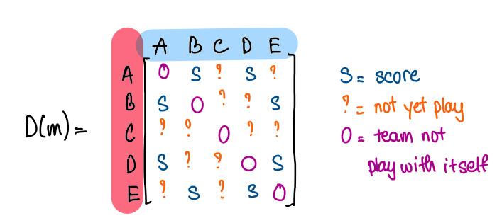
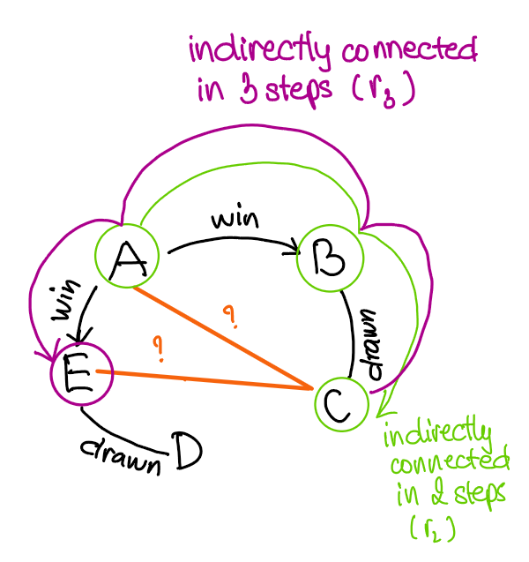
1. Introduction:
Dominance Matrix Definition D(m):
Tool that allows to rank teams in a round-robin tournament when not all teams has played each other
We will be looking at m=13,16,19 and 22
Objective:
Assess the reliability level of the dominance matrix
Using AFL historical data in 2014
Key terminology
Different methods:
Win-loss record: 4 points for a win, 0 point for a loss and 2 points for a draw.
Ratio – score matrices: based on the actual point scored and conceded in each game.
First order ranking (r₁) is the actual ranking based on win-loss or ratio-score that have been played:
r₁ = How good the teams are directly (D(m)1) – How bad the teams are directly(D(m)^{T})1
Second order ranking (r₂) is the predicted ranking for teams that have not been played yet by
looking at the played games around them:
r₂ = How good the teams are directly and indirectly (D(m))²1 - How bad the teams are directly and indirectly((D(m)²)^{T})1
Example. Predict the ranking between team A and C based played game between A vs B & B vs C.
Third order ranking (r₃) similar to (r₂) but the team connected in 3 steps (as per figure 2):
Example. Predict the ranking between team E and C based played game between C vs B & B vs A & A vs E.
Figure 1: Example of matrix
Point conceded by each team
Point scored by each team
Figure 2: Example of higher order ranking

Slide 3
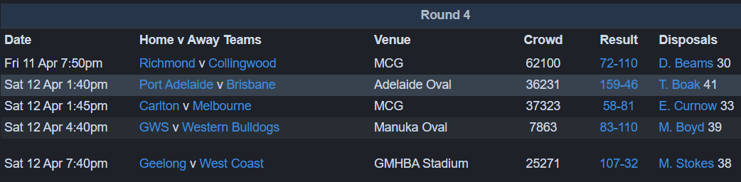
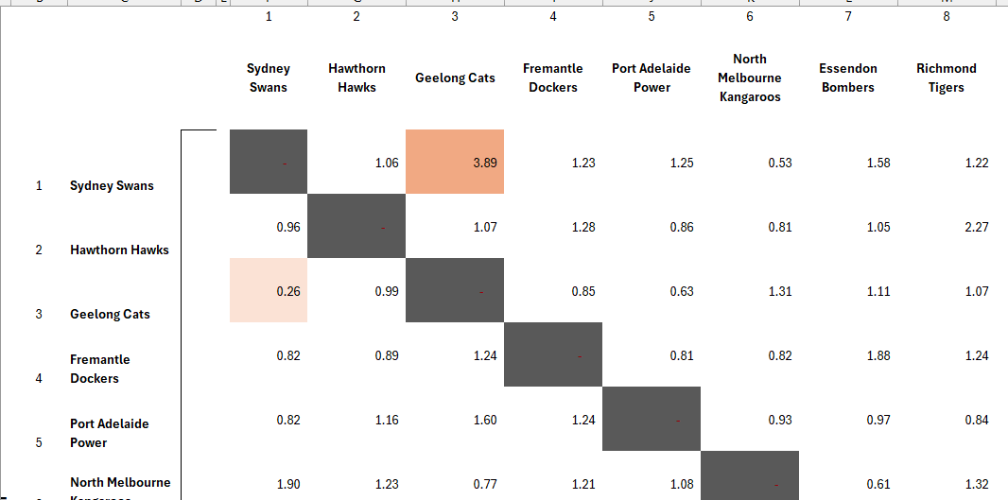
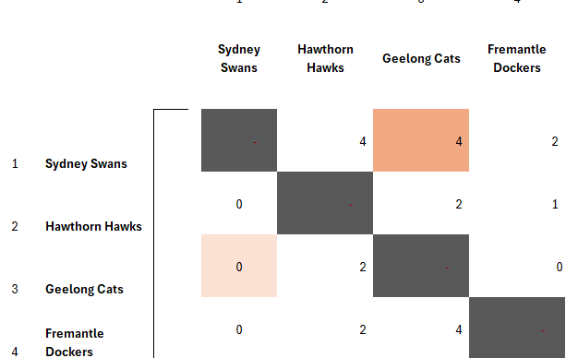
1. Introduction:
Figure 3. Round 4 AFL 2014 result
Why ratio – score method?
In AFL, point margins can vary significantly.
Ratio-score provide:
Better view of team performance by differentiating
team that barely win with team that consistently outperforms its opponents.
Increase prediction power based on teams’ performance.
Sydney Swans performs at 3.89 time better than Geelong cats
Ratio-score matrix
Win-loss record
Can’t tell how much they win by, just know that it is a win

Slide 4
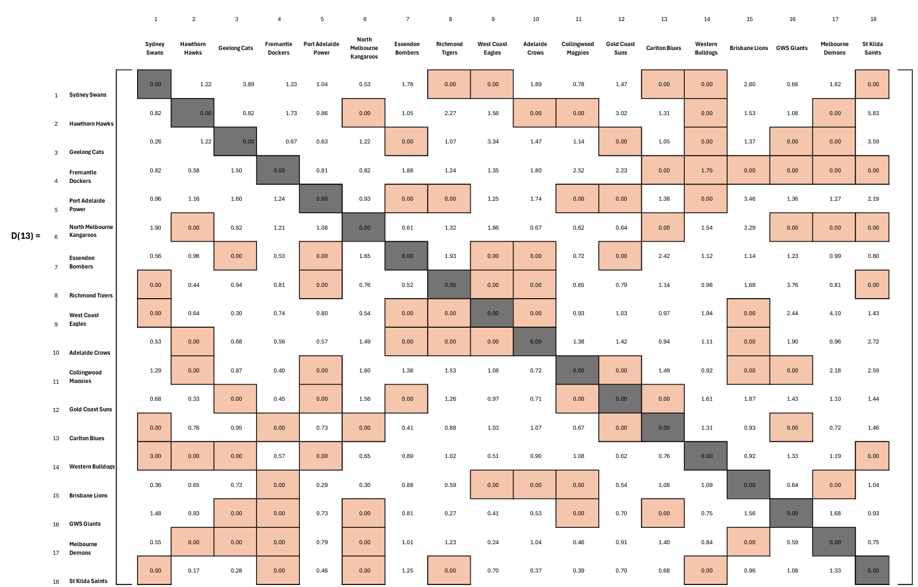
2. Analysis of Data
Early in the season, lot of games that have not been play.
We will see what the prediction ranking be like later.
Example of calculations:
Teams: Team 1 vs. Team 7
Round: up to round 13
Result: Team 1 is 1.78 time as good as Team 7
D(m) calculation:
D(13)_{1,7} = 1.78 (team 1 dominates)
D(13)_{7,1} = 0.56 (team 7 losses)
Team 1 (r₁) = (D(m)1)– (D(m)^{T})1 = 28.87 - 12.67 = 8.92. Team 2 (r₂)= (D(13))²1 - ((D(m)²)T)1 = 542.07 -242.78 = 141.76
Games not yet played
Team not play itself

Slide 5
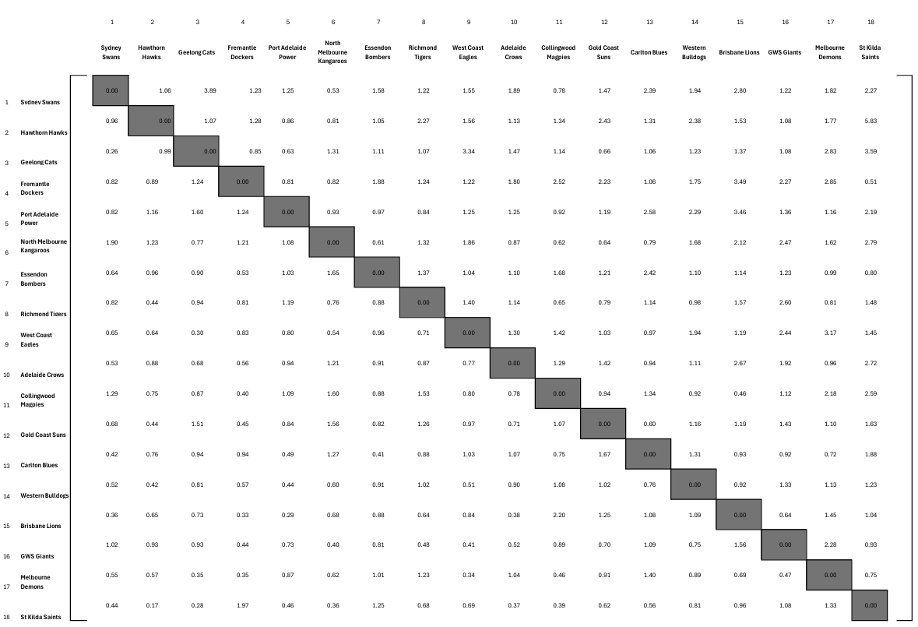
Later in the season at round 22 where most games have been played, some teams has played with each other twice
Take average of the two games as this will give a balanced view of team performance.
Consider full context of the competition across two teams
Account for all data available.
D(22)=

Slide 6
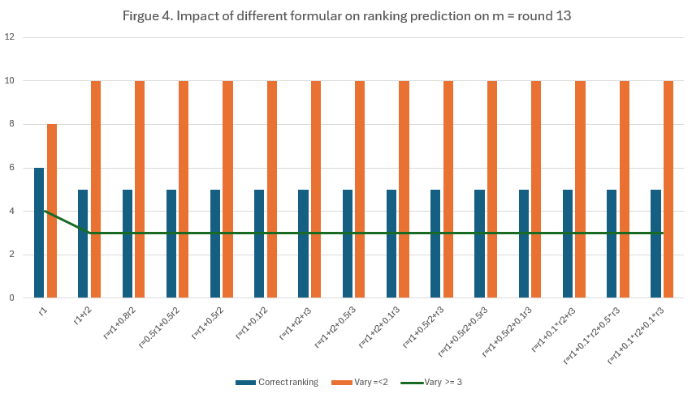
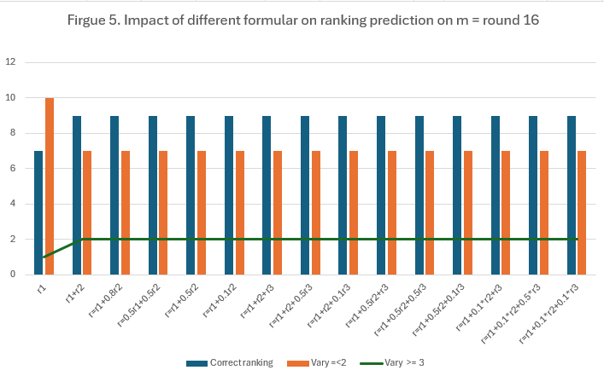
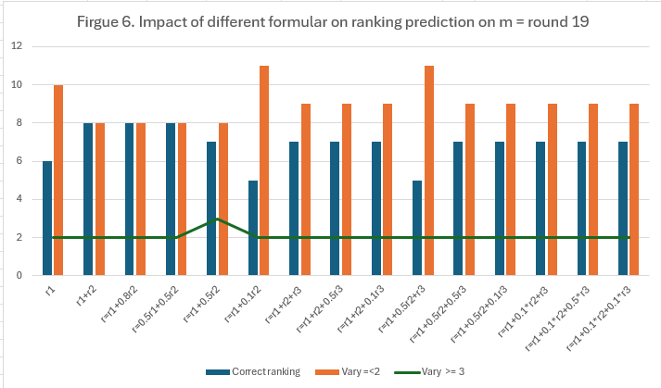
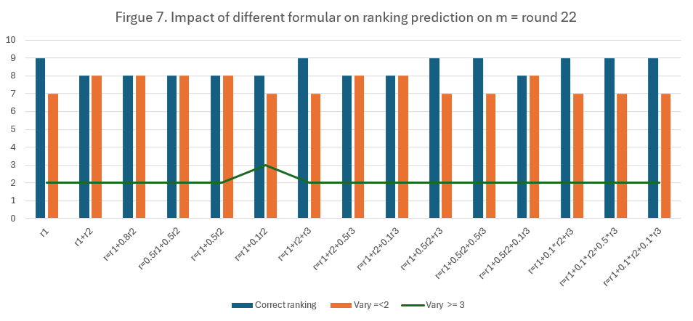
Overall, from figures above, the impact of higher order ranking r3 is not significant as well as changing degree of r2 in some earlier round (m=13 & 16) doesn’t have any impact. However, as we move toward later the season, r2 is more important as when r2 reduce to 50% in round 19, the prediction accuracy decreased. Similarly, at 10% r2 the prediction of round 22 reduced remarkably. Together with the impact of higher ranking (r3), the prediction accuracy increased in round 22.

Slide 7
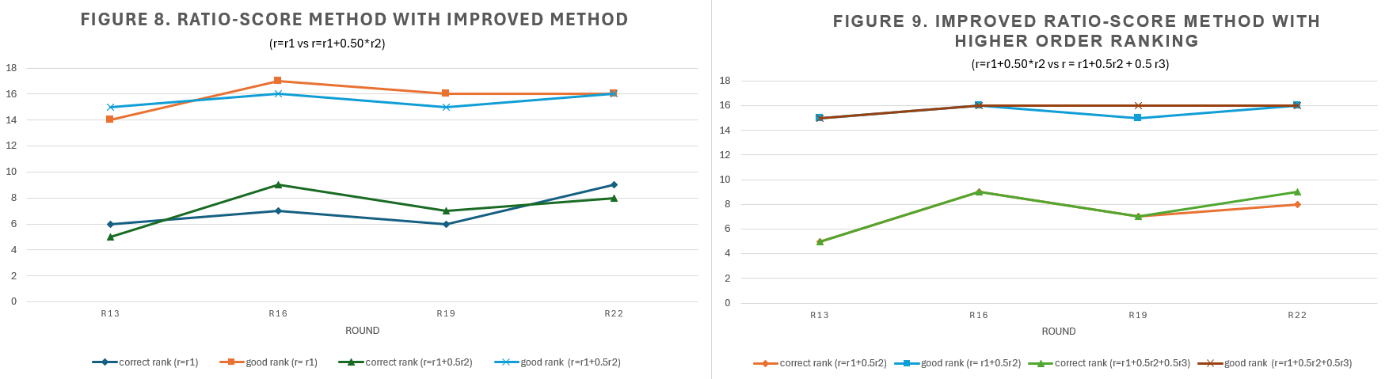
In figure 8, the graph shows a comparison between first ranking where r = r₁ with an improved method where r = r₁ + 0.5r₂ across all 22 rounds. This compares between correct ranking prediction with a good ranking which is the sum of correct ranking and prediction with only up to 2-unit gaps.
Similarly in figure 9, we determine the difference between improved ranking with higher order ranking r = r₁ + 0.5r₂ ₊ 0.5r_{3.}
From these 2 figures, we can see that with an introduce of higher ranking the overall accuracy of ladder prediction increases.
As the result, the best possible formula for predicting the true ranking is r = r₁ + 0.5r₂ ₊ 0.5r₃.
Additionally, these graphs show that by using the second-order ranking, the dominance matrix method can correctly predict the rankings of 9 teams as early as when 𝑚=16, which is the same as at 𝑚=22. Moreover, at 𝑚=16, the model provides an accurate ranking for 17 teams overall, which is even higher than the performance at 𝑚=22.

Slide 8
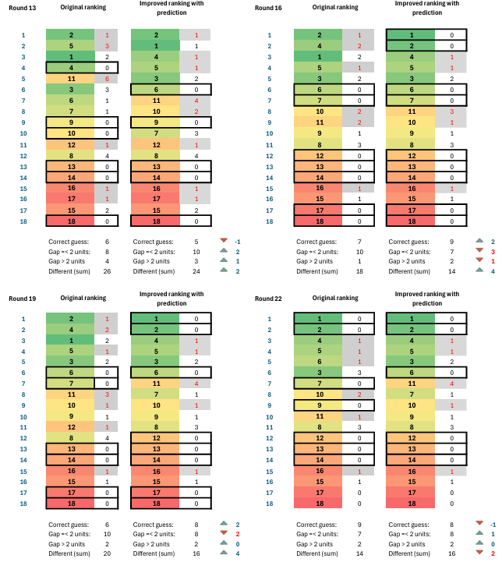
2. Result and conclusion
Limitation:
Relying solely on dominance matrices to predict team rankings early in the season is insufficient.
Other factors, such as injuries, strategic changes, and individual team member performance, must also be considered.
B. Accuracy:
Dominance matrices provide a good overall indicator of team strength.
The ratio-score method reflects team performance consistently across the season.
Despite its limitations, we observe clear patterns from figure 10:
Top-performing teams (in greenish color) (e.g., teams 1, 2, 3, 4) consistently rank in the top 6.
Low-performing teams (in red and pink colour)(e.g., teams 18, 17, 16, 15) consistently remain at the bottom.
However, predicting middle-ranked teams is challenging due to various factors involved.
Reference List:
Footywire (2014) Footy Wire AFL Statistics.
https://www.footywire.com/afl/footy/ft_match_list?year=2014
Figure 10. Comparison of overall ranking across different round

